Slide 1
CSE 2500: Introduction to Discrete Systems
Lecture 1: Course Introduction
Kaleel Mahmood
Department of Computer Science and Engineering
University of Connecticut

Slide 2
Course Objective: Learn discrete math, logic and formal reasoning
Example: Prove 2=1
Let $a$ and $b$ be non-zero such that: | $$a=b$$

Slide 3
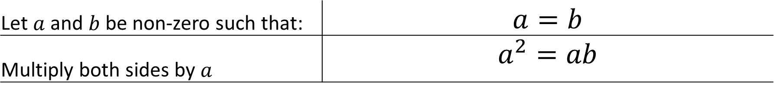
Course Objective: Learn discrete math, logic and formal reasoning
Example: Prove 2=1
Let $a$ and $b$ be non-zero such that: | $$a=b$$
Multiply both sides by $a$ | $$a^{2}=ab$$

Slide 4
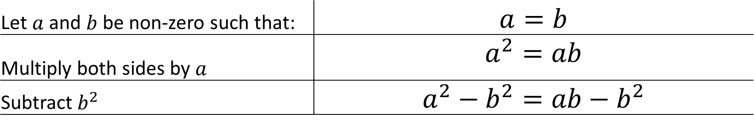
Course Objective: Learn discrete math, logic and formal reasoning
Example: Prove 2=1
Let $a$ and $b$ be non-zero such that: | $$a=b$$
Multiply both sides by $a$ | $$a^{2}=ab$$
Subtract $b^{2}$ | $$a^{2}−b^{2}=ab−b^{2}$$

Slide 5
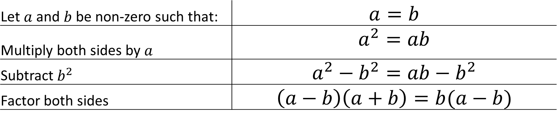
Course Objective: Learn discrete math, logic and formal reasoning
Example: Prove 2=1
Let $a$ and $b$ be non-zero such that: | $$a=b$$
Multiply both sides by $a$ | $$a^{2}=ab$$
Subtract $b^{2}$ | $$a^{2}−b^{2}=ab−b^{2}$$
Factor both sides | $$\left(a−b\right)\left(a+b\right)=b(a−b)$$

Slide 6
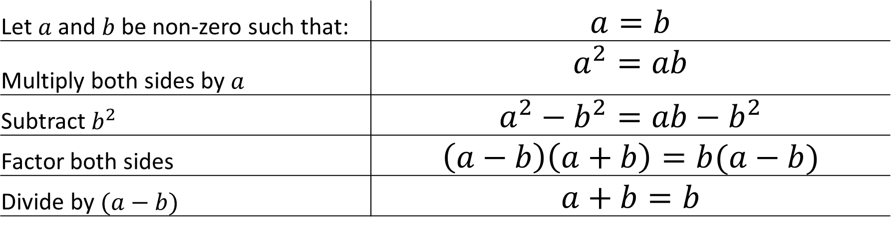
Course Objective: Learn discrete math, logic and formal reasoning
Example: Prove 2=1
Let $a$ and $b$ be non-zero such that: | $$a=b$$
Multiply both sides by $a$ | $$a^{2}=ab$$
Subtract $b^{2}$ | $$a^{2}−b^{2}=ab−b^{2}$$
Factor both sides | $$\left(a−b\right)\left(a+b\right)=b(a−b)$$
Divide by $(a−b)$ | $$a+b=b$$

Slide 7
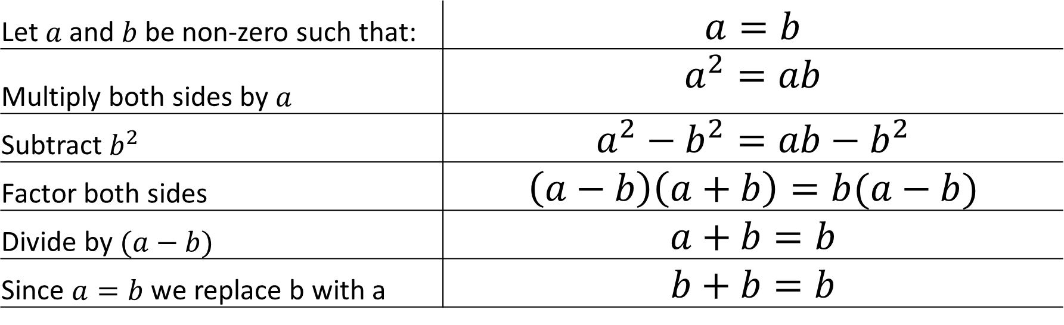
Course Objective: Learn discrete math, logic and formal reasoning
Example: Prove 2=1
Let $a$ and $b$ be non-zero such that: | $$a=b$$
Multiply both sides by $a$ | $$a^{2}=ab$$
Subtract $b^{2}$ | $$a^{2}−b^{2}=ab−b^{2}$$
Factor both sides | $$\left(a−b\right)\left(a+b\right)=b(a−b)$$
Divide by $(a−b)$ | $$a+b=b$$
Since $a=b$ we replace b with a | $$b+b=b$$

Slide 8
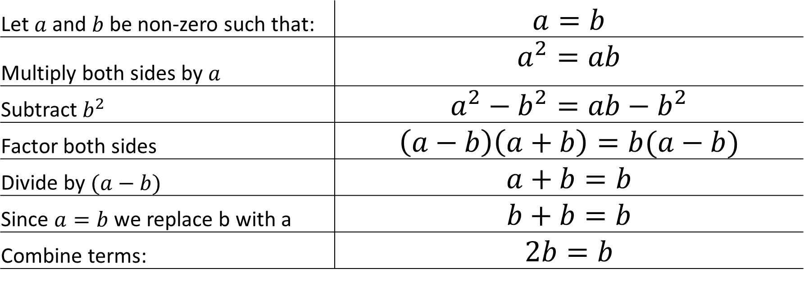
Course Objective: Learn discrete math, logic and formal reasoning
Example: Prove 2=1
Let $a$ and $b$ be non-zero such that: | $$a=b$$
Multiply both sides by $a$ | $$a^{2}=ab$$
Subtract $b^{2}$ | $$a^{2}−b^{2}=ab−b^{2}$$
Factor both sides | $$\left(a−b\right)\left(a+b\right)=b(a−b)$$
Divide by $(a−b)$ | $$a+b=b$$
Since $a=b$ we replace b with a | $$b+b=b$$
Combine terms: | $$2b=b$$

Slide 9
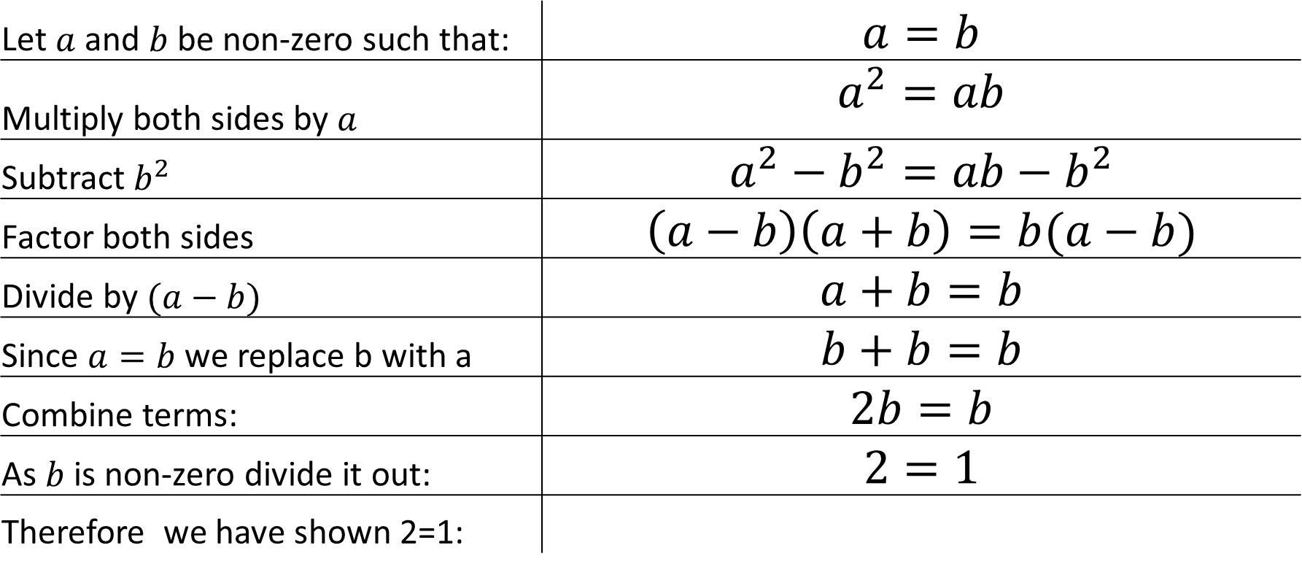
Course Objective: Learn discrete math, logic and formal reasoning
Example: Prove 2=1
Let $a$ and $b$ be non-zero such that: | $$a=b$$
Multiply both sides by $a$ | $$a^{2}=ab$$
Subtract $b^{2}$ | $$a^{2}−b^{2}=ab−b^{2}$$
Factor both sides | $$\left(a−b\right)\left(a+b\right)=b(a−b)$$
Divide by $(a−b)$ | $$a+b=b$$
Since $a=b$ we replace b with a | $$b+b=b$$
Combine terms: | $$2b=b$$
As $b$ is non-zero divide it out: | $$2=1$$
Therefore we have shown 2=1:

Slide 10
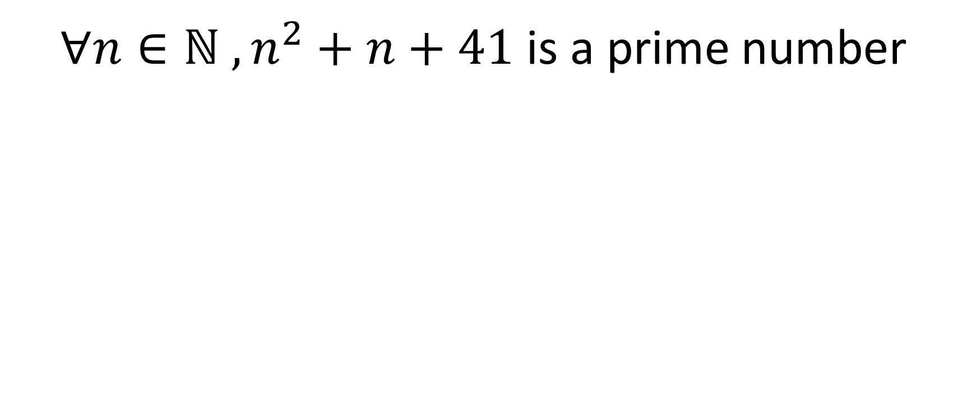
Example from MIT’s “Mathematics for Computer Science”
$∀n∈\text{ℕ} , n^{2}+n+41$ is a prime number
The expression we are evaluating
A natural number greater than 1 that is not a product of two smaller natural numbers
“For All” symbol
The natural numbers
i.e. {0,1,2,..}
How do we determine if this statement is true or false?

Slide 11
Example from MIT’s “Mathematics for Computer Science”
$∀n∈\text{ℕ} , n^{2}+n+41$ is a prime number
How do we determine if this statement is true or false?
n=0 | 41 | Prime

Slide 12
Example from MIT’s “Mathematics for Computer Science”
$∀n∈\text{ℕ} , n^{2}+n+41$ is a prime number
How do we determine if this statement is true or false?
n=0 | 41 | Prime
n=1 | 43 | Prime

Slide 13
Example from MIT’s “Mathematics for Computer Science”
$∀n∈\text{ℕ} , n^{2}+n+41$ is a prime number
How do we determine if this statement is true or false?
n=0 | 41 | Prime
n=1 | 43 | Prime
n=2 | 47 | Prime
n=3 | 53 | Prime

Slide 14
Example from MIT’s “Mathematics for Computer Science”
$∀n∈\text{ℕ} , n^{2}+n+41$ is a prime number
How do we determine if this statement is true or false?
n=0 | 41 | Prime
n=1 | 43 | Prime
n=2 | 47 | Prime
n=3 | 53 | Prime
… | … | …
n=39 | 1601 | Prime

Slide 15
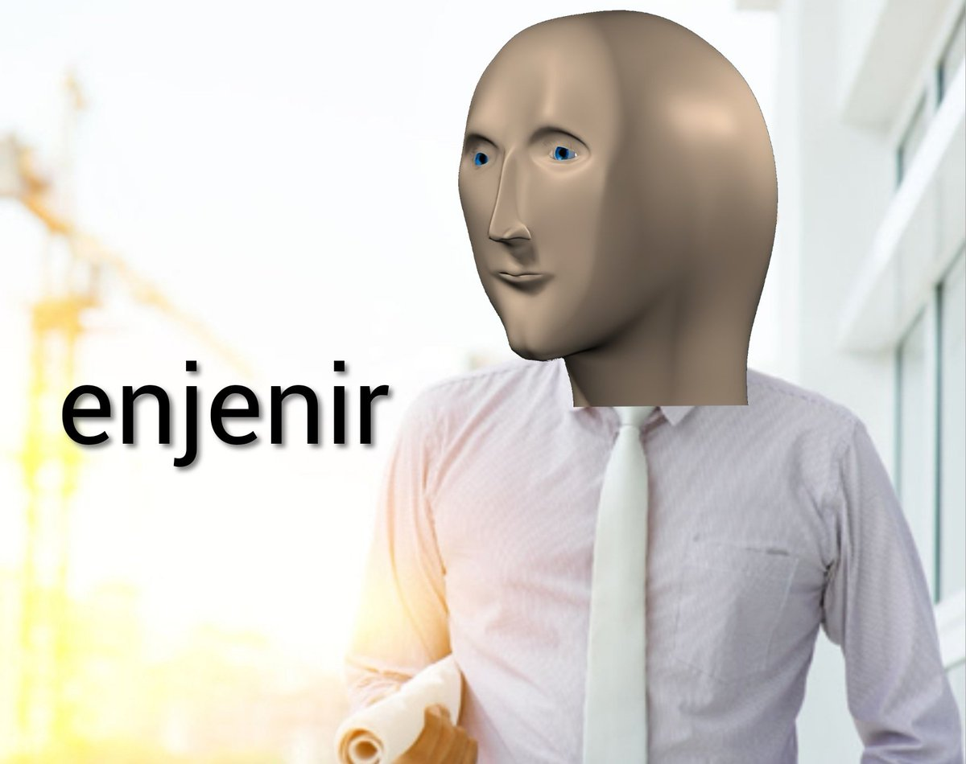
Example from MIT’s “Mathematics for Computer Science”
$∀n∈\text{ℕ} , n^{2}+n+41$ is a prime number
How do we determine if this statement is true or false?
n=0 | 41 | Prime
n=1 | 43 | Prime
n=2 | 47 | Prime
n=3 | 53 | Prime
… | … | …
n=39 | 1601 | Prime
Checked 40 test cases:

Slide 16
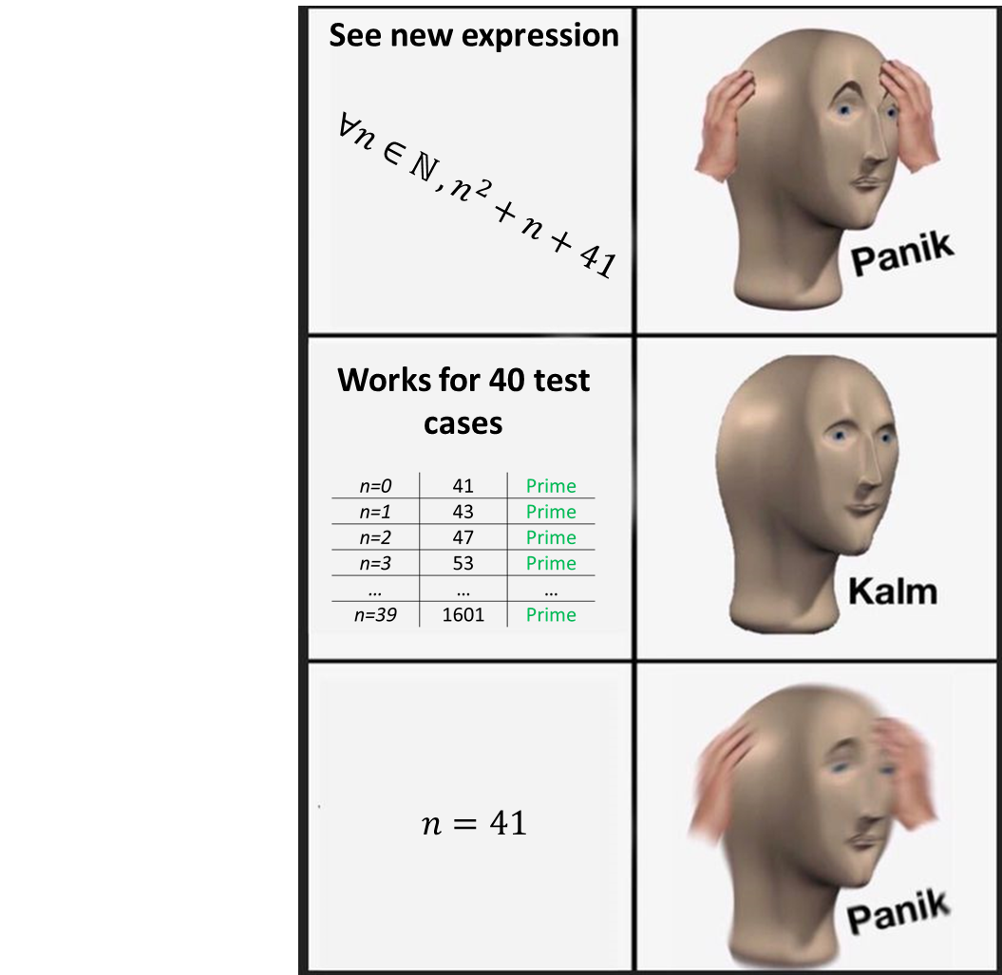
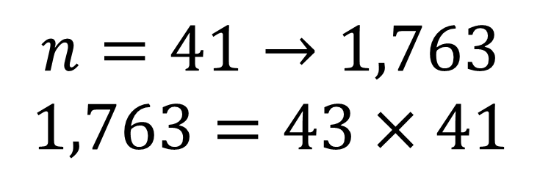
Example from MIT’s “Mathematics for Computer Science”
$∀n∈\text{ℕ} , n^{2}+n+41$ is a prime number
$$n=41→1,763$$
$$1,763=43×41$$

Slide 17

Why am I taking this course?
Knowing theory will help you design better algorithms and write better programs: BECOME A BETTER PROGRAMMER.
Data structures in programming are based on theory covered by discrete math: sets, list, arrays, trees, etc.
Uconn Course Requirements
UConn Students

Slide 18

Answering some basic course questions
How will I be graded?
Do you need a textbook?
What topics are covered?
What is the meaning of life?

Slide 19
How will you be graded?
7-10 Homework Assignments (30%)
Depends on course pacing/material covered.
1 Midterm Exam (30%)
1 Final Exam (40%)

Slide 20
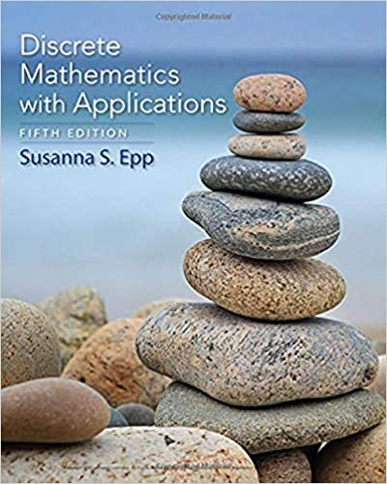
Do you need a textbook?
Online Resources:
https://ocw.mit.edu/courses/electrical-engineering-and-computer-science/6-042j-mathematics-for-computer-science-fall-2010/
https://ocw.mit.edu/courses/electrical-engineering-and-computer-science/6-042j-mathematics-for-computer-science-fall-2010/readings/
www.Google.com
Textbook: Discrete Mathematics with Applications 5th Edition
Pros/Cons of Textbook
Pros/Cons of using online material
Pro: Can supplement lecture material.
Cons: Expensive.
Pro: May be used as firewood once the course is done.
Pro: Extra video lectures and reading from MIT.
Pro: Its MIT and free.
Con: May not be exactly the same as material we cover.
Con: Cannot be used as firewood once the course is done.

Slide 21
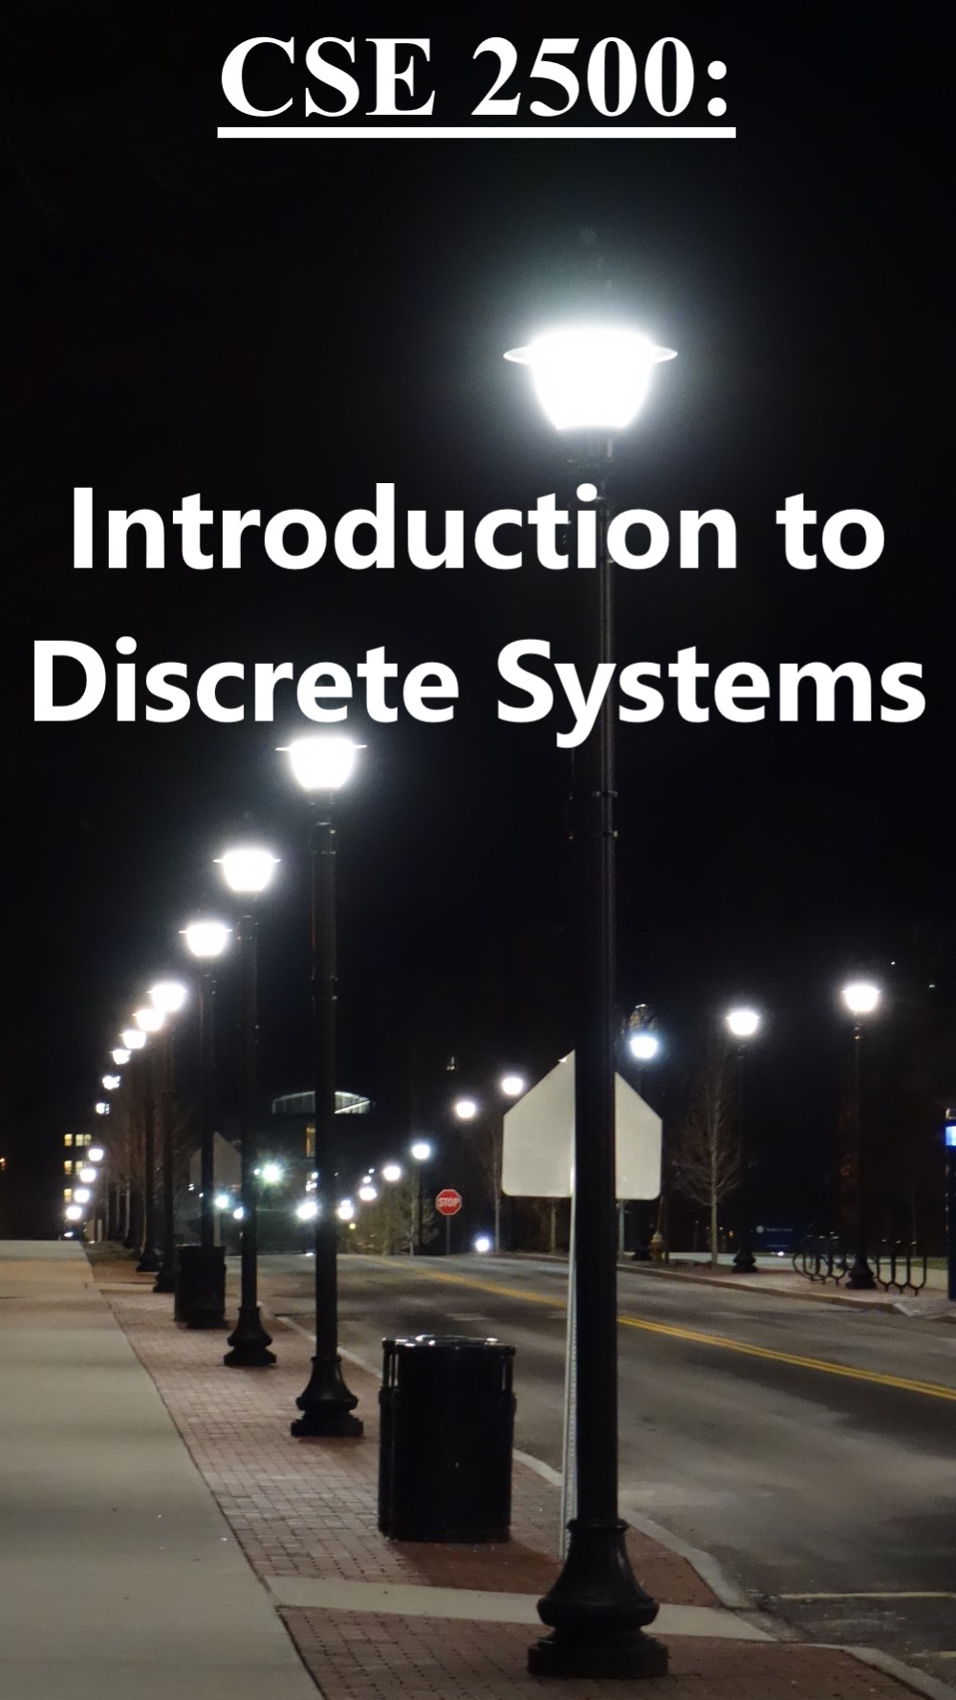
Preliminary List of Topics
Sets
Logic
Sequences
Proofs
Recursion
Induction
Special Topics: (Optimization and Machine Learning)

Slide 22
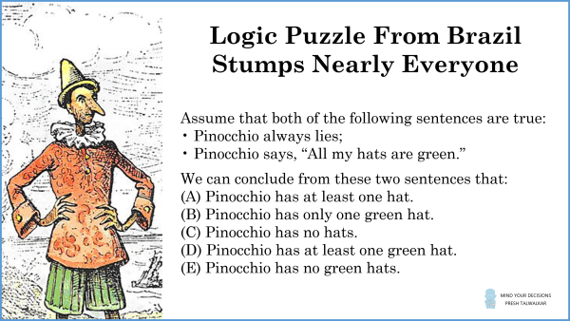
Test you knowledge now,
test your knowledge again at the end of the semester:

Slide 23
Questions?

Slide 24
Figure Sources
https://pbs.twimg.com/media/EdDxRTzXoAcHRRY.jpg
https://en.meming.world/images/en/7/79/Panik_Kalm.jpg
https://m.media-amazon.com/images/I/51nxbInnFpL.jpg
https://images-na.ssl-images-amazon.com/images/I/51JHfPwgAJL._SX398_BO1,204,203,200_.jpg
https://i.kym-cdn.com/entries/icons/facebook/000/018/489/nick-young-confused-face-300x256-nqlyaa.jpg
https://ctl.s6img.com/society6/img/LBmnjjTY80iBCUPGHRKFatk_LMg/w_1500/prints/~artwork/s6-original-art-uploads/society6/uploads/misc/318f6925be6d47c885d1cddffc05328b/~~/uncle-sam-i-want-you-prints.jpg
https://mindyourdecisions.com/blog/2022/06/22/brazilian-olympiad-pinocchios-green-hats-viral-question/

